Slide 1
Procure to pay(P2P) process
NAME : HARI VISWESH MCA (SS)
REG NO : 2019272009
Guide : Ms.S.Kanimozhi
Teaching Fellow

Slide 2
OVER-ALL ARCHITECTURE

Slide 3
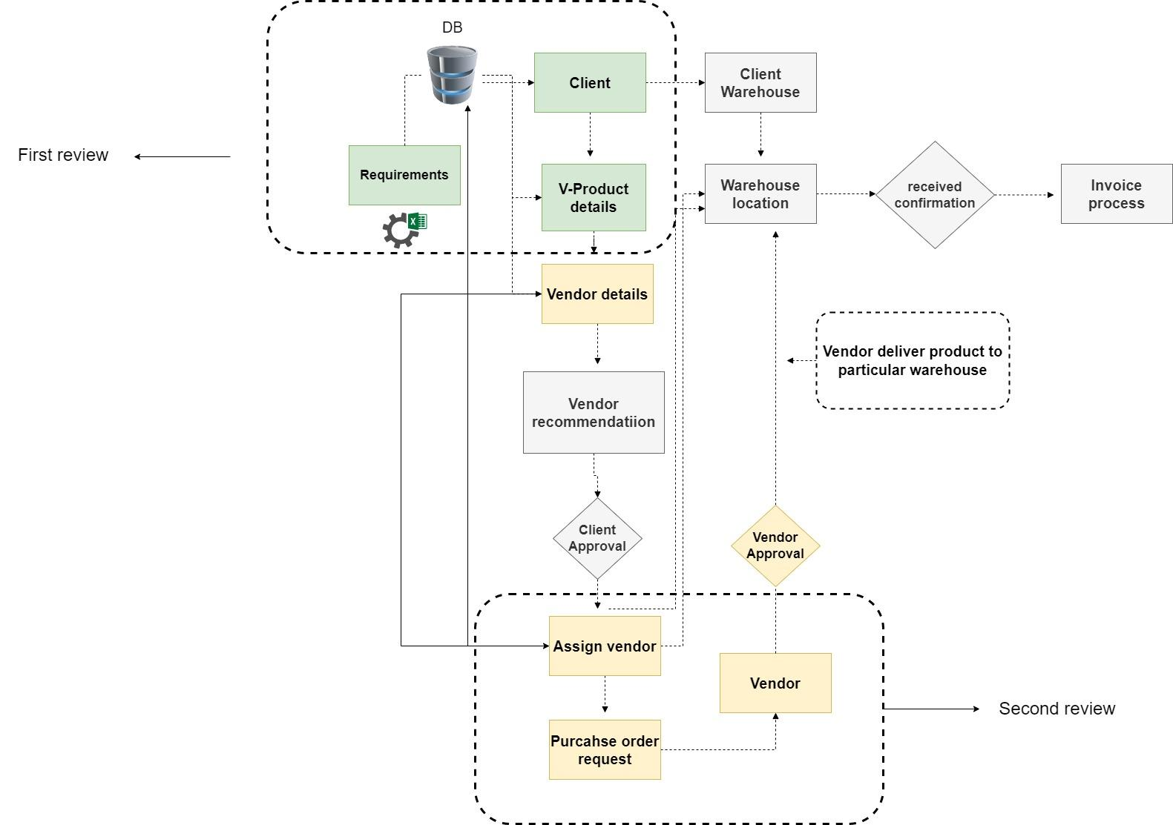

Slide 4
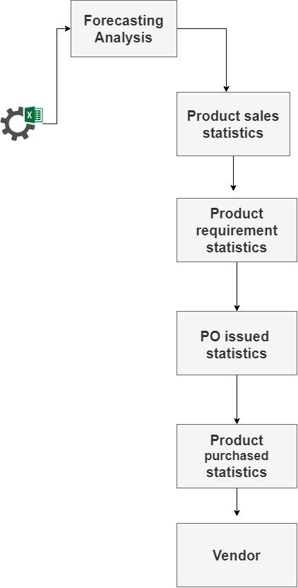

Slide 5
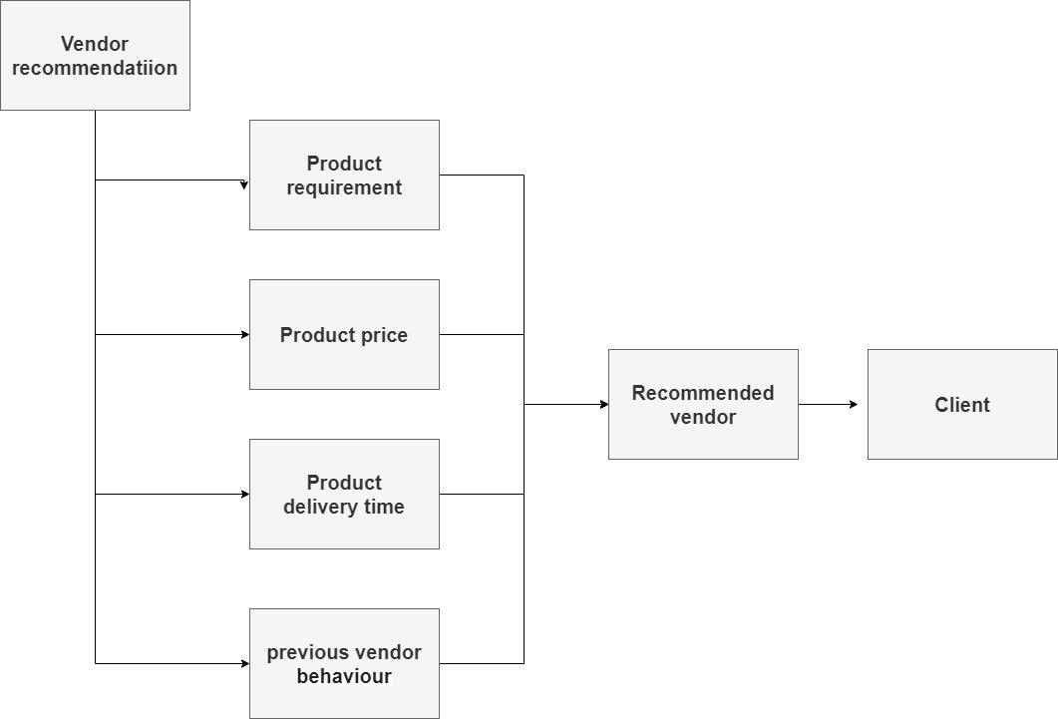

Slide 6
LIST OF MODULES

Slide 7
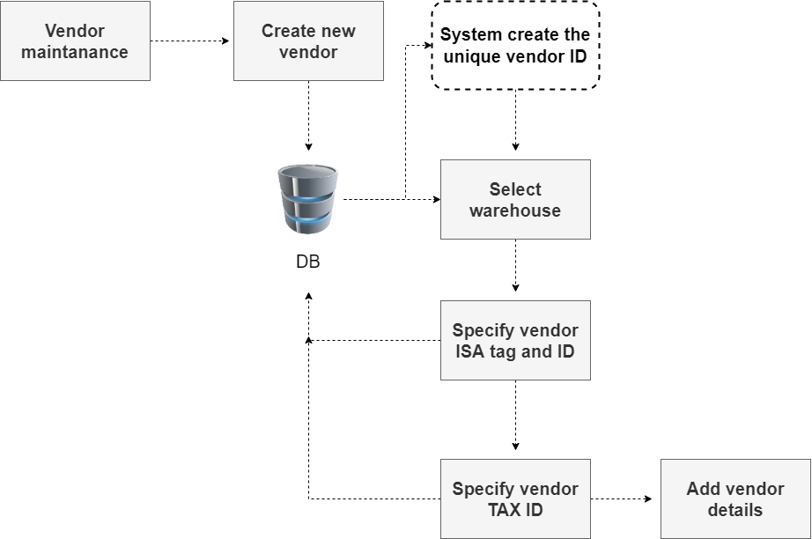
Maintaining Vendor details

Slide 8
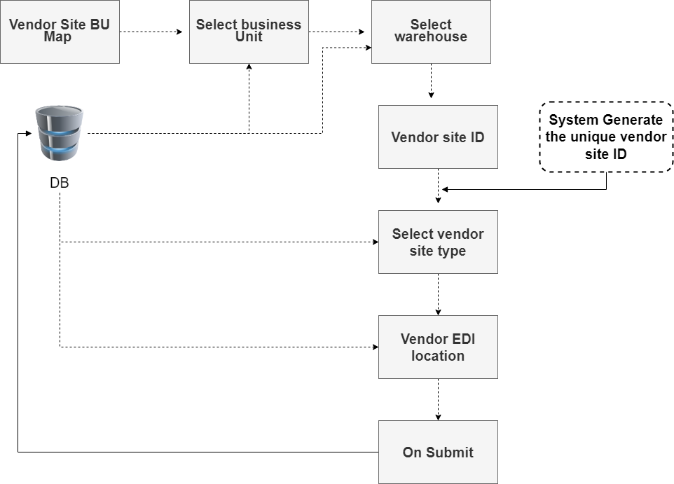
Mapping Vendor with BU(BUSINESS UNIT) and Site

Slide 9
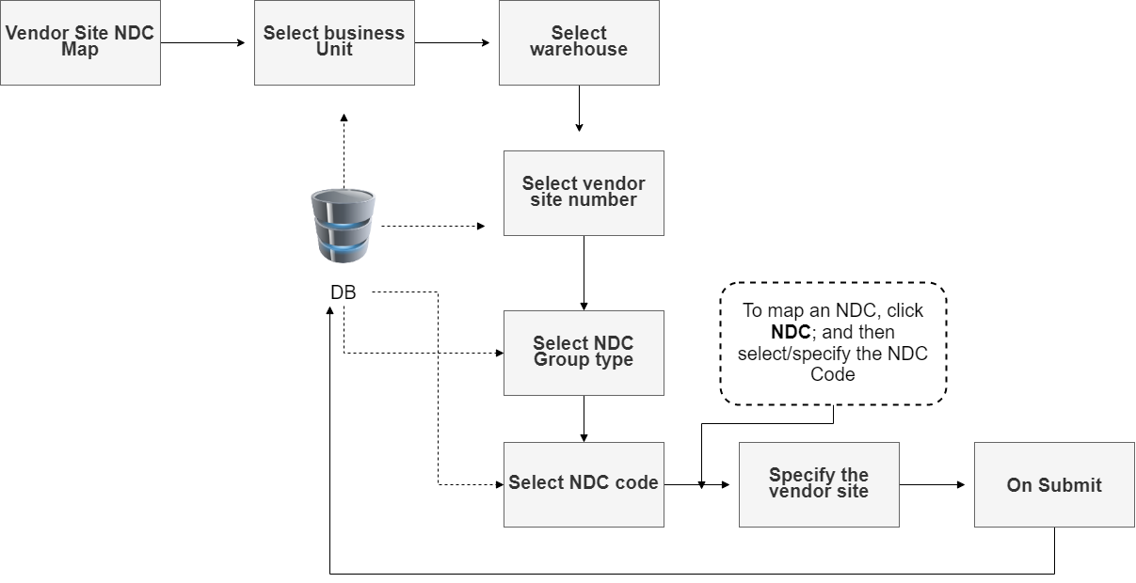
Mapping NDC OR SKU with Vendor Site and BU(BUSINESS UNIT)

Slide 10
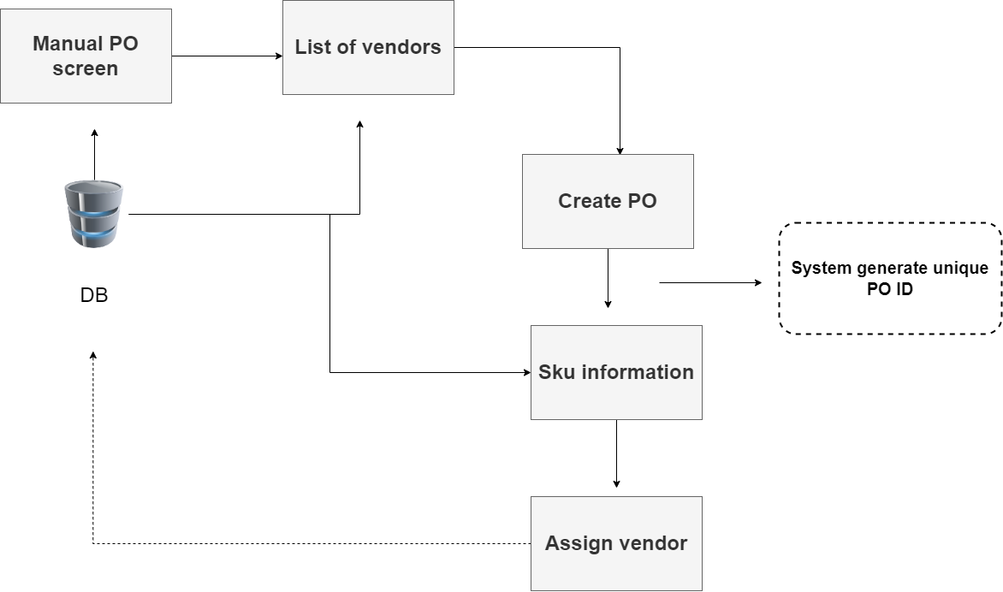
Vendor manual po creation

Slide 11
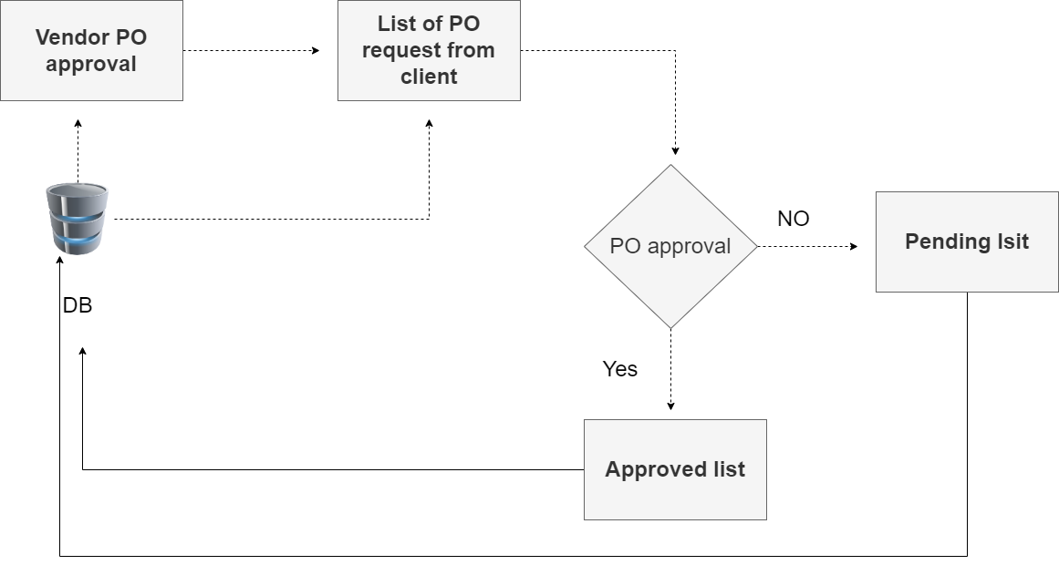
Vendor PO approval

Slide 12
MODULE IMPLEMENTATION

Slide 13
Maintaining Vendor Details
We can use the Vendor screen for creating and maintaining the vendor (vendor group) details, which will be used to group the vendor sites.
Click submit to create the new Vendor and specify the description.
The system automatically generates the Vendor ID.
Select the Warehouse against the Vendor has to be created.
Specify the unique Vendor ISA Tag / Receiver ID for the Vendor.
Specify the Vendor Tax Id.
On clicking Submit, the system displays the defined Vendor details in the grid.

Slide 14
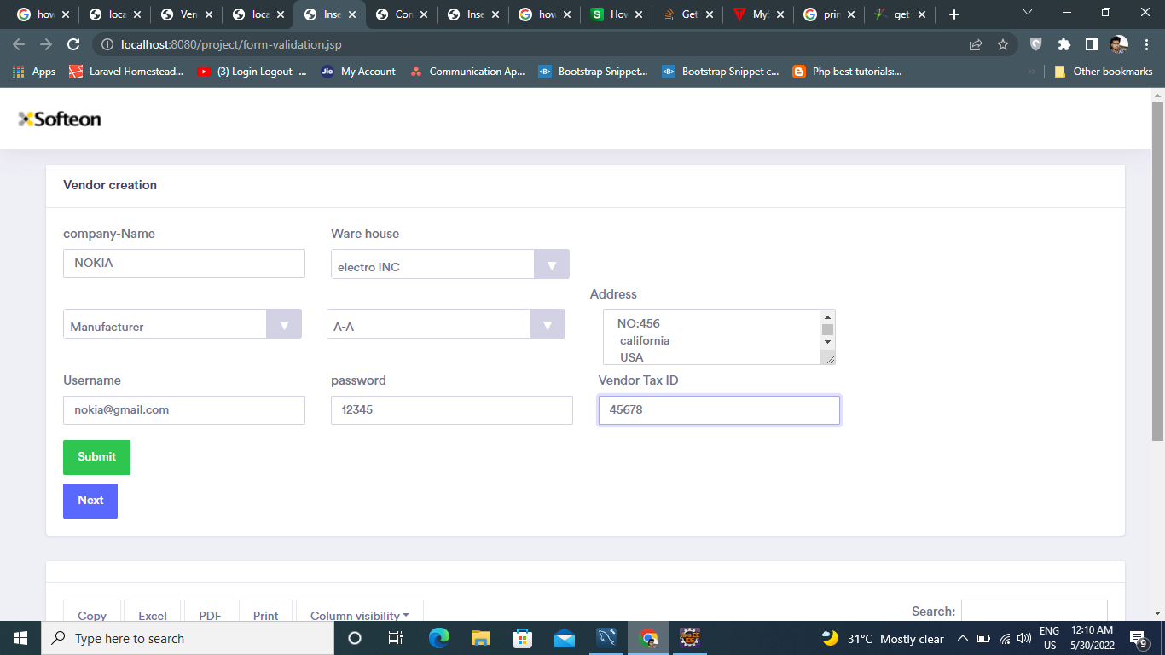

Slide 15
Maintaining Vendor Site BU Map Details
You can use the Vendor Site BU(Business unit) Map screen for mapping a Vendor with a Site and maintaining individual vendor details Click submit to create the new Vendor and specify the description.
Select the Business Unit, Warehouse and Site to which the Vendor belongs
Select the Vendor Site Type and Vendor Site Sub Type to indicate whether the Vendor Site is of ‘Internal’, ‘Manufacturer’ or ‘Vendor’.
Select the Schedule Method as ‘Morning’, ‘Evening’ or ‘Both’ to indicate whether the inventory computation scheduler must be run only in the morning, evening, or both for the NDCs that are mapped with the Business Unit and Vendor Site.
Specify the EDI Location ID.
Click near Address and specify/select the address of the Vendor Site.

Slide 16
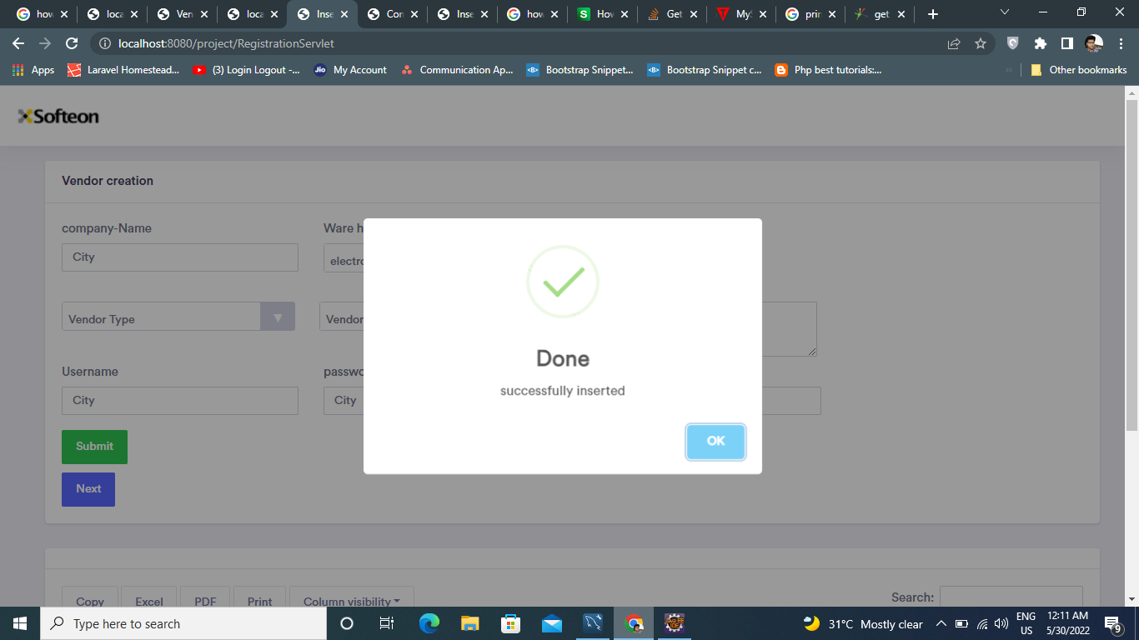

Slide 17
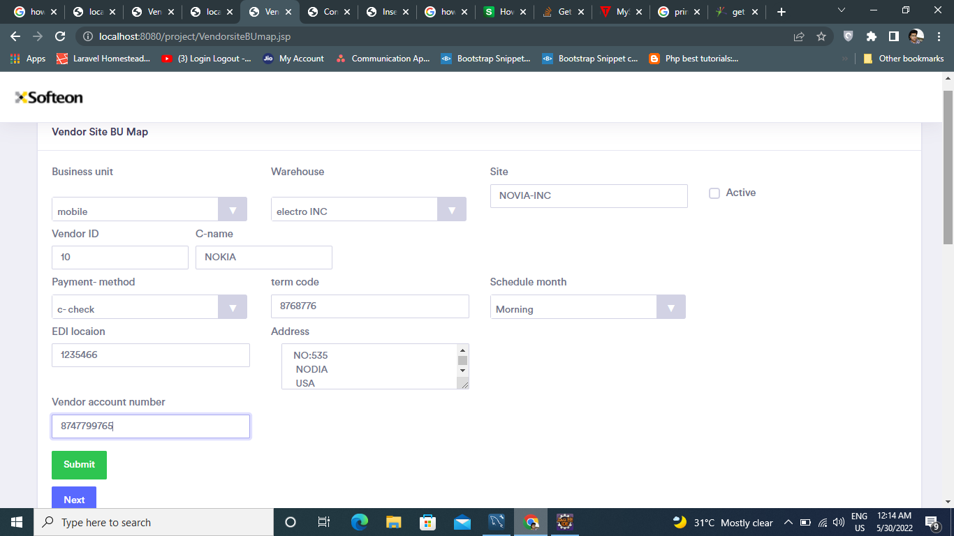

Slide 18
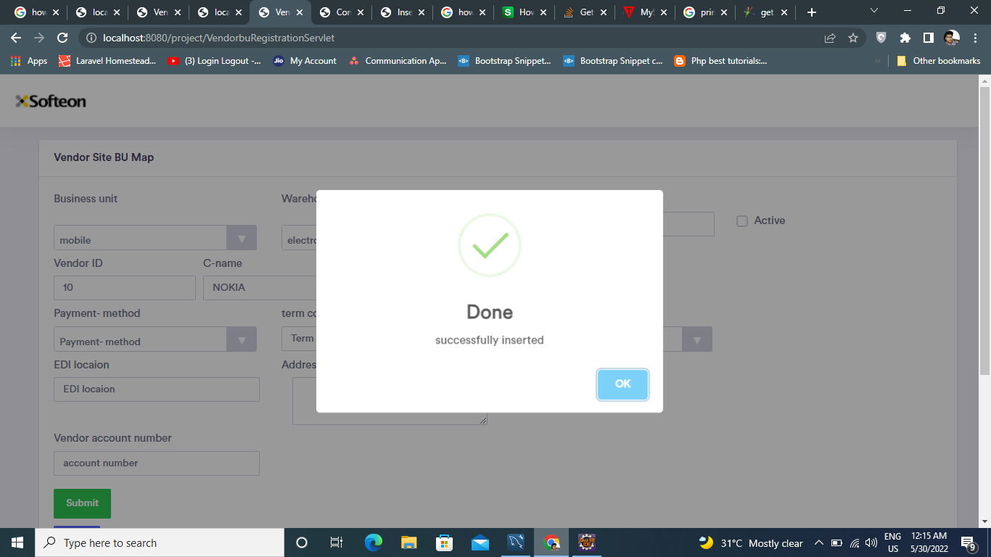

Slide 19
Mapping NDC with Vendor Site and BU
You can use the Vendor Site BU NDC (National Drug Code) or SKU (Stock Keep Unit) Map screen for mapping an NDC/SKU with Vendor Site and BU
Select the Business Unit, Warehouse and Site to which the Vendor belongs
To map a NDC Group, click NDC Group Type and select the desired NDC Group Type from the list; and then select/specify the NDC Group Code.
To map an NDC, click NDC; and then select/specify the NDC Code.
Specify/select the Vendor Site Number to which the selected NDC Group or NDC must be mapped.

Slide 20
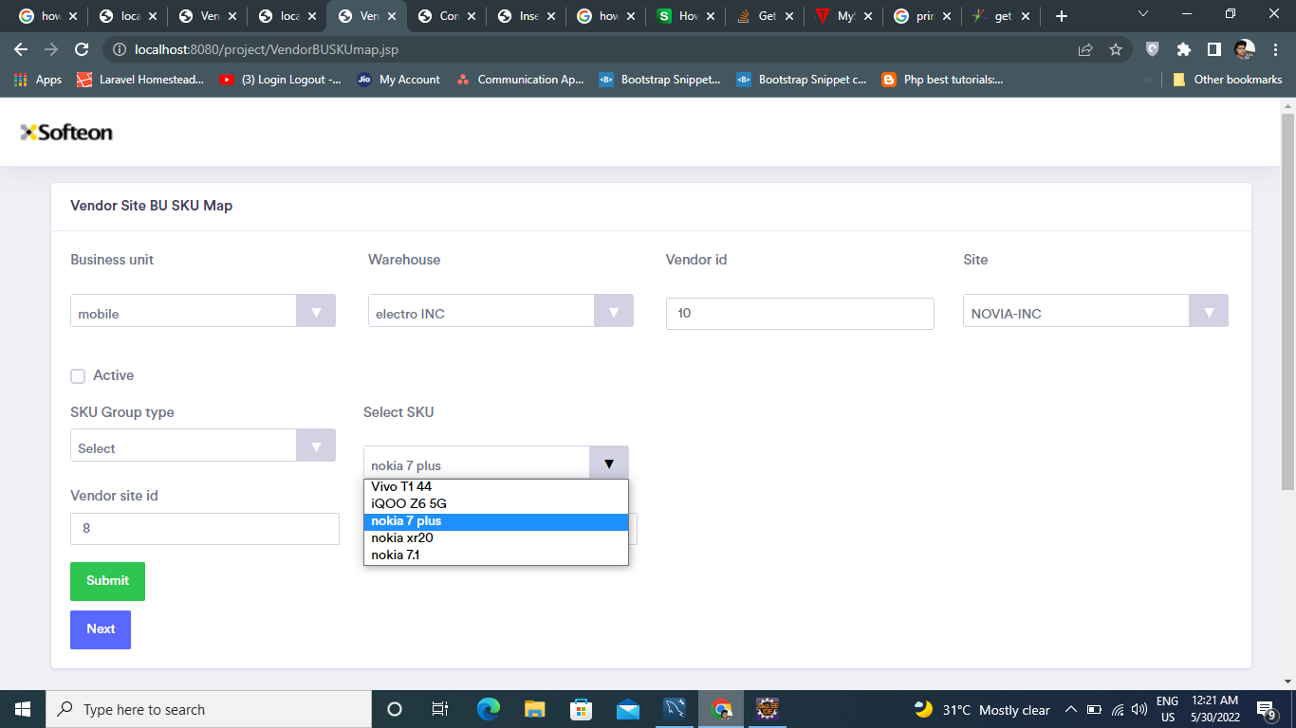

Slide 21
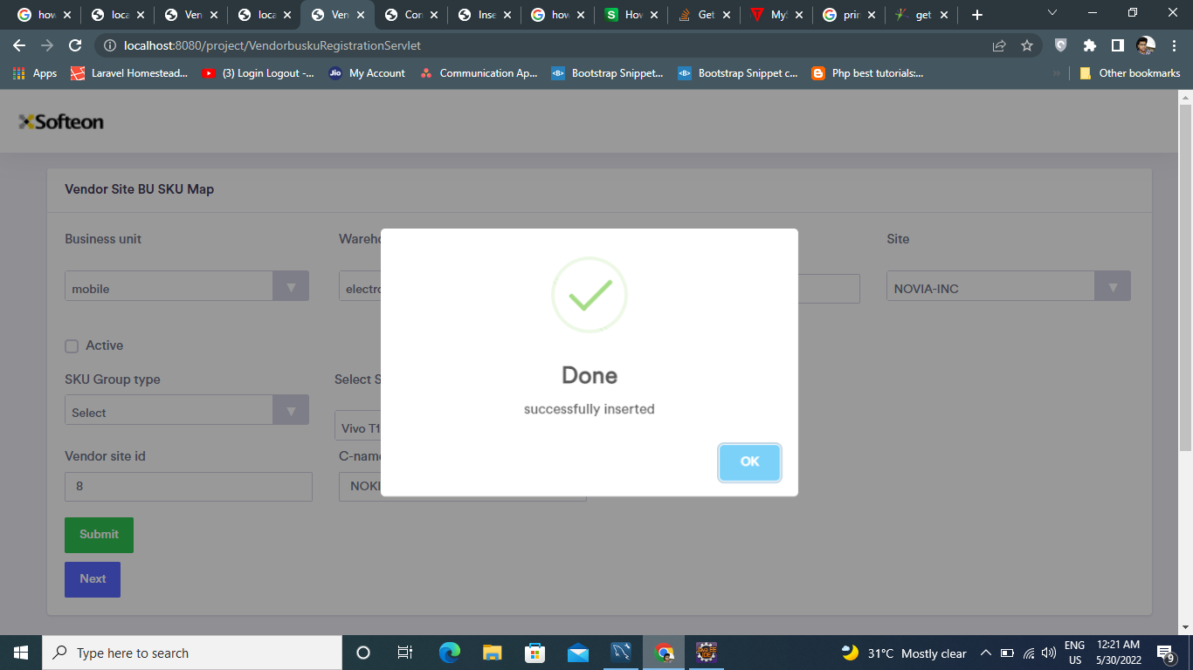

Slide 22
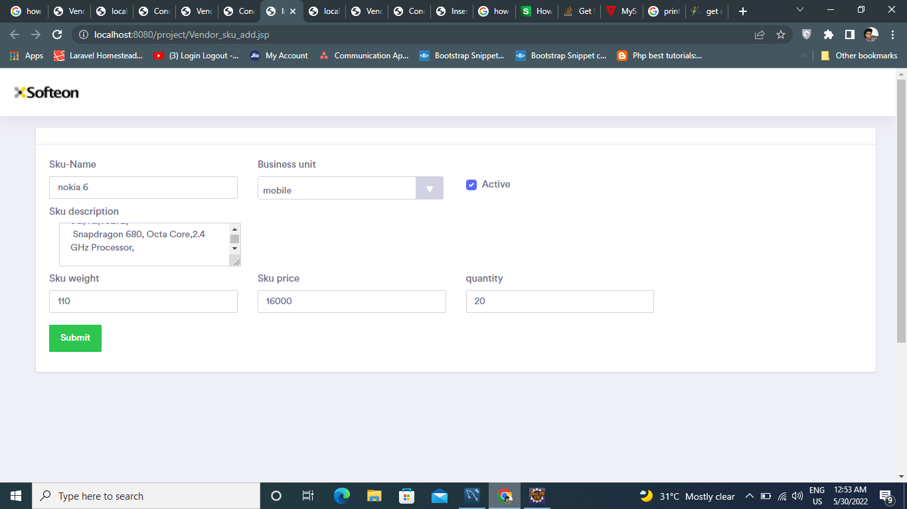
SKU adding screen

Slide 23
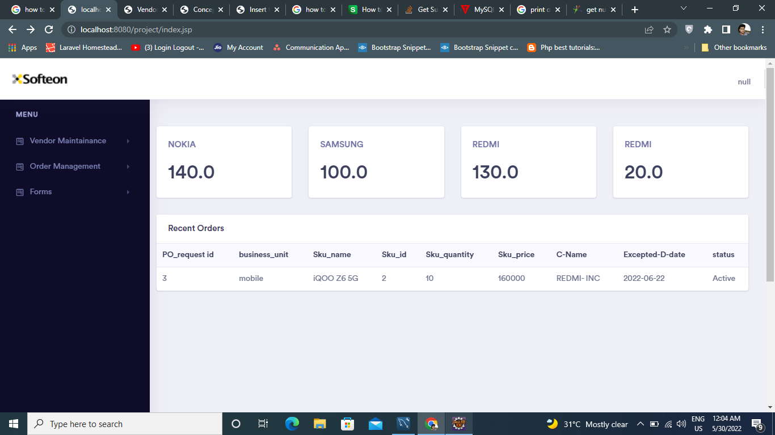
User dashboard screen

Slide 24
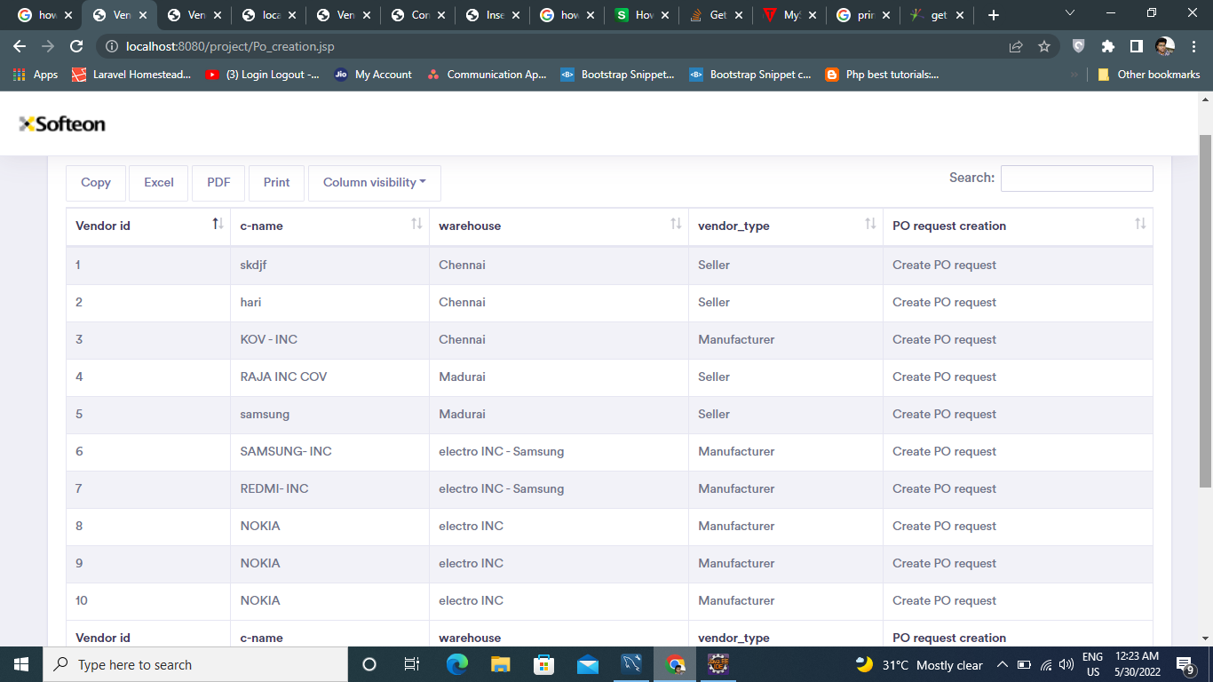
Manual PO request creation

Slide 25
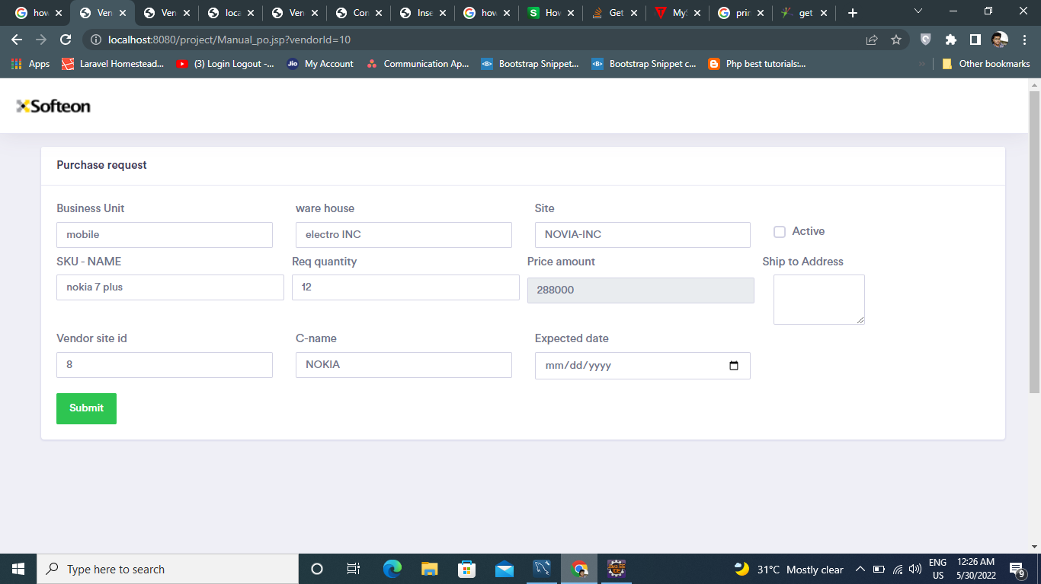
Manual PO request creation

Slide 26
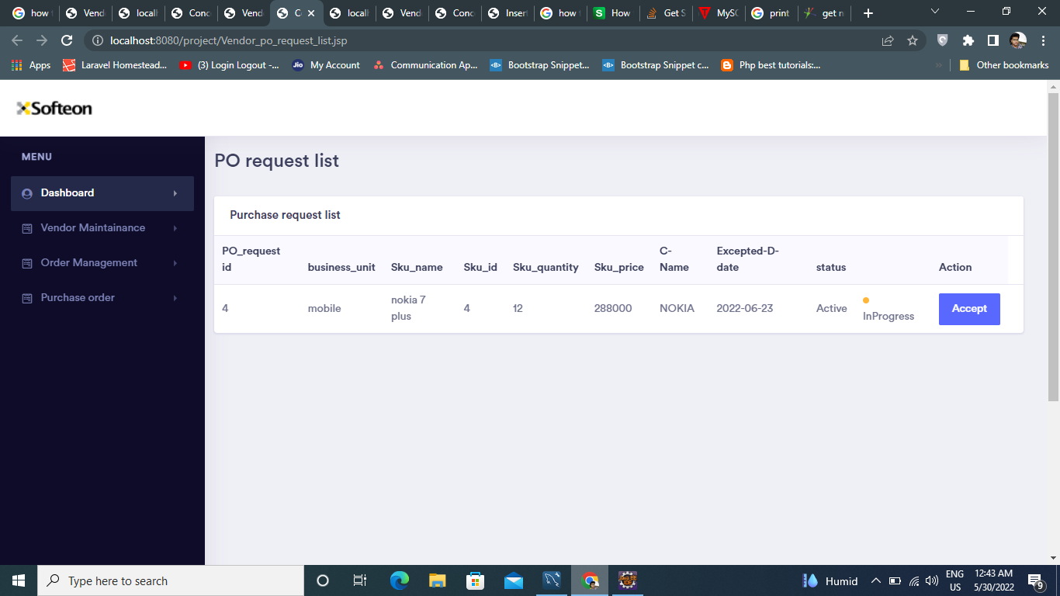
Vendor PO pending

Slide 27
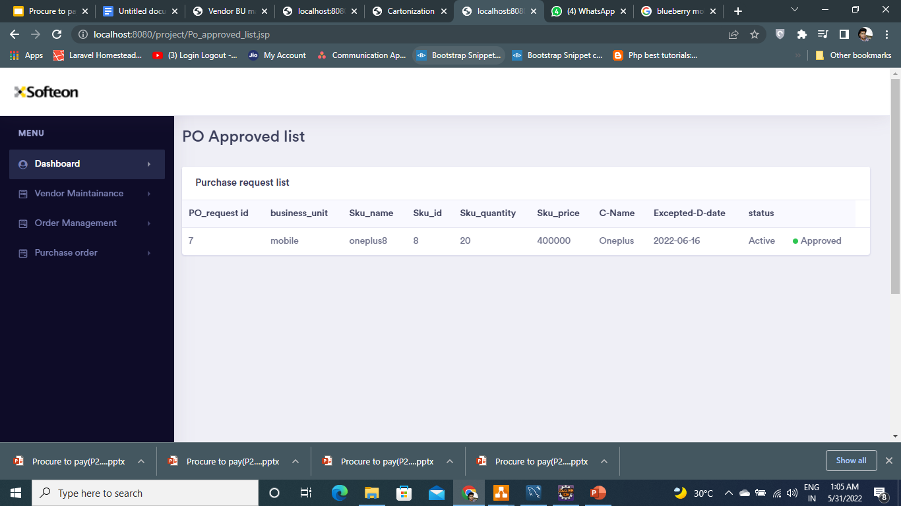
Vendor PO Approval

Slide 28
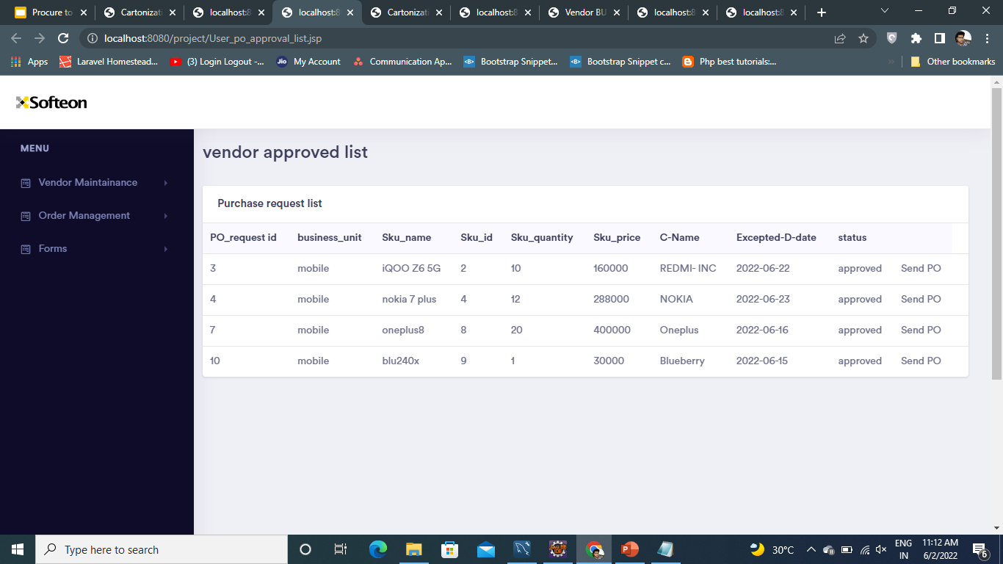

Slide 29
IMPLEMENTATION PLATFORM / FRAMEWORK
Front End: Java, HTML, JDBC, jsp servlet
Backend: MySQL
Application: eclipse IDE

Slide 30
REFERENCES
https://www.ariba.com/solutions/business-needs/what-is-procure-to-pay#:~:text=Procure%2Dto%2Dpay%20is%20the,and%20reconciliation%3B%20invoicing%20and%20payment.
https://kissflow.com/procurement/procure-to-pay-process-guide/
https://www.manutan.com/blog/en/glossary/what-does-procure-to-pay-mean-definition-solutions-benefits
https://precoro.com/blog/procure-to-pay-process/

Slide 31
Thank you

